Slide 1

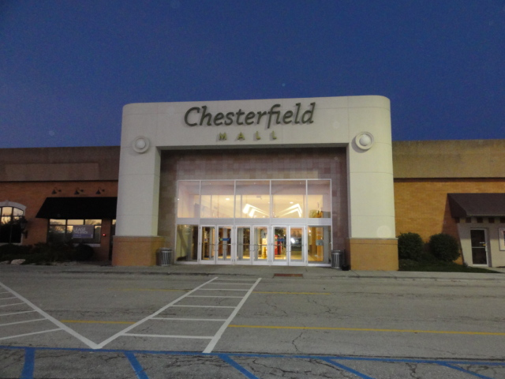
LINDBERGH
Chesterfield Mall
Chesterfield, MO
Prepared by: Rick Zavala
Week 10 of 10

Slide 2
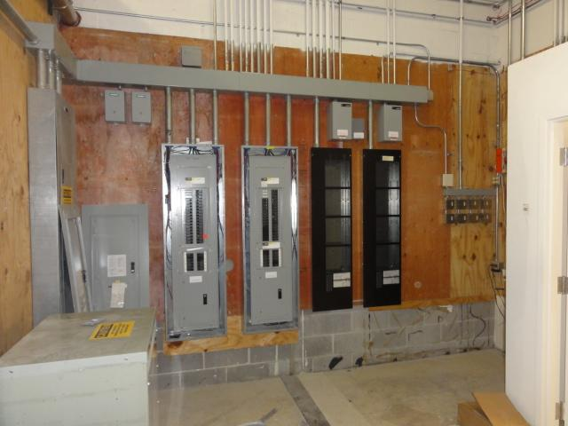
Electrical panels
Fitting rooms area doors and walls painted
Electrical Panels stock room
No change only modification
Modifications complete 12/1/14

Slide 3
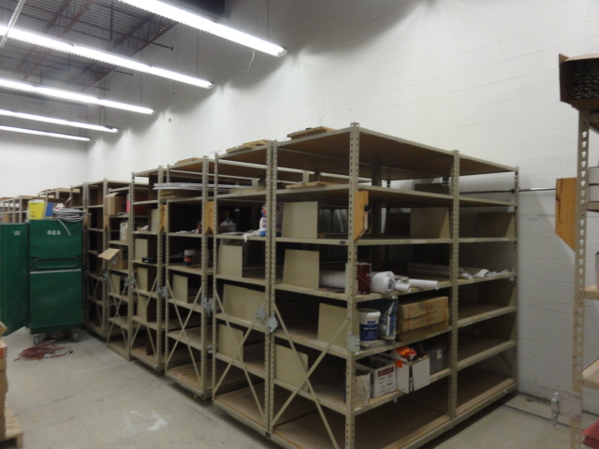
Existing stock room
Existing stock room shelving.
Painted one coat
12/19 and existing VCT strip &
Wax 12/23 for turnover on 12-24

Slide 4
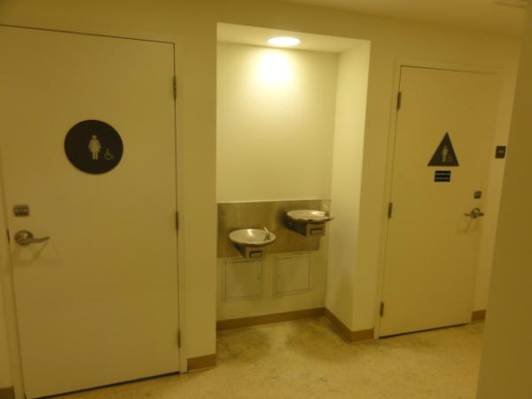
Existing restroom hall ways
Signage and water coolers
VCT patched, new vinyl wall base installed 12/11 complete
Hallways one coat paint applied
Painting to be complete 12/19 and final cleaning 12/23

Slide 5
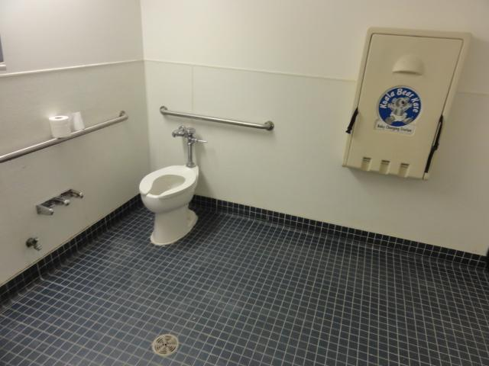
Existing restrooms
Existing restrooms
Fully painted and new EMR lights installed 12/1
Inspected 12/11
Cleaning TBD 12/23

Slide 6
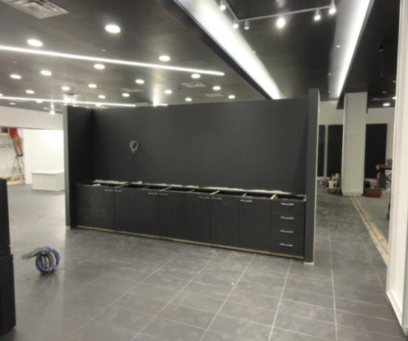
Sales floor at POS
Back wrap installed 12/1, tile complete
New electric feed installed for back wrap sign. Wall repainted per Marco
Was white per drawings
1) Cash wrap delayed, back wrap sign , trim, millwork panels , lights and counter tops not on site as of 12/18
Estimated delivery date 12/22
2) Expansion floor cover not installed
Estimated delivery and install 12/23
3) Fabric for Barrisol columns not complete
Replacement LED arrived today will install 12/19
Fabric to be installed 12/22

Slide 7
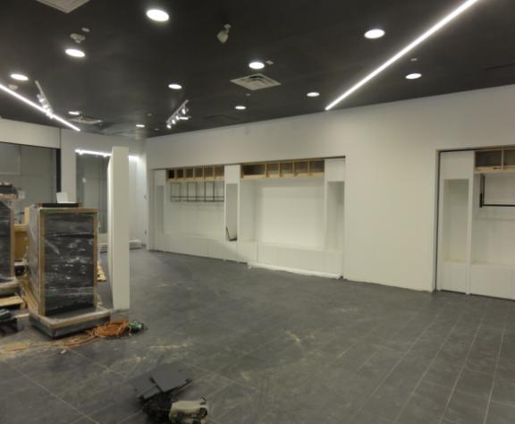
Sales floor “F” fixtures North wall
Fixtures installed & lighting partially
7 LED transformers & can lights
Notice no hang bars in the picture of the F fixture to the LHS
Per Email today they are to be installed two per fixture
Fixtures installed per plans

Slide 8
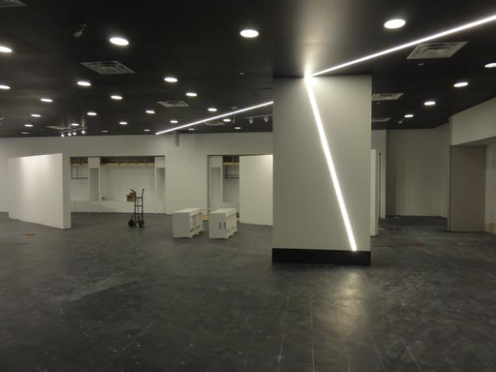
Sales floor
Middle of store north east
showing FINELIGHTS w/ new tile
Base, floor tile complete
Walls painted white per plan

Slide 9
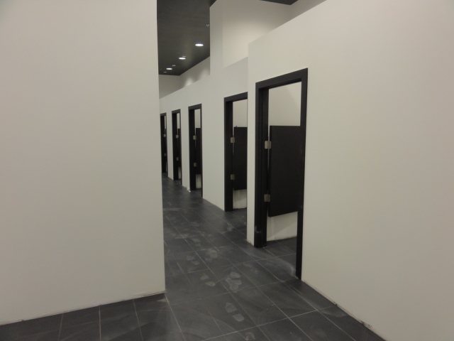
Fitting room area
Fitting rooms area doors and walls
Painted, floor tile 100% complete
Wall base & door hardware
12/19-12/20

Slide 10
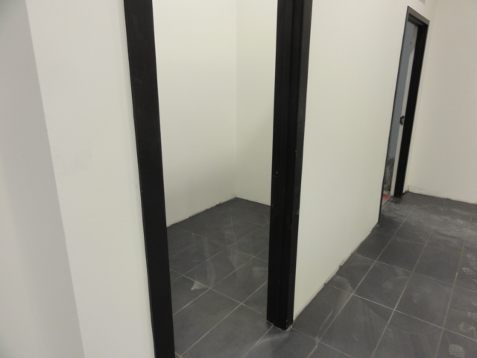
Fitting rooms
Interior of ADA fitting
Room.
Wall base and benches TBD 12/19 -12/20

Slide 11
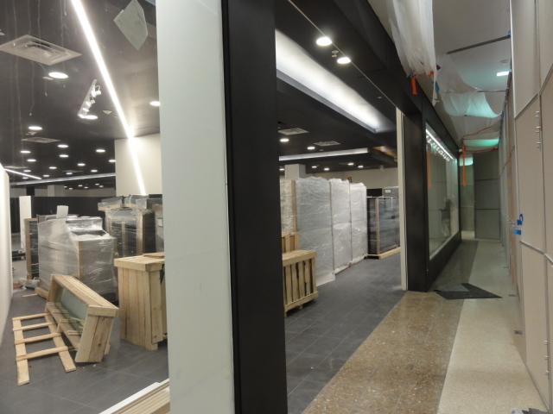
Store front from north to south
Store front glass & break metal
Complete
Cleaning 12/23

Slide 12
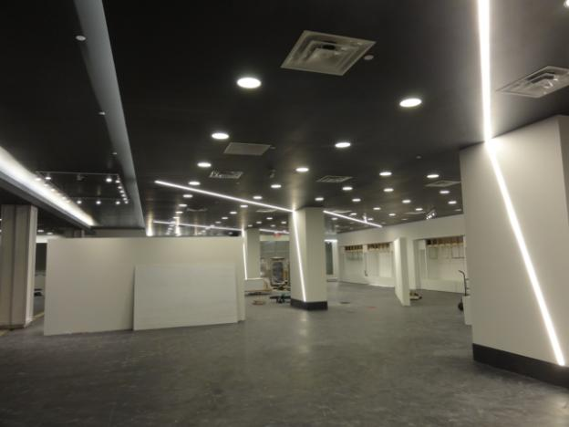
Sales floor
Sales floor looking from back to front
Will need to be stocked into store, un wrapped , assembled, set into place
& trash removed
Cleaning 12/23

Slide 13
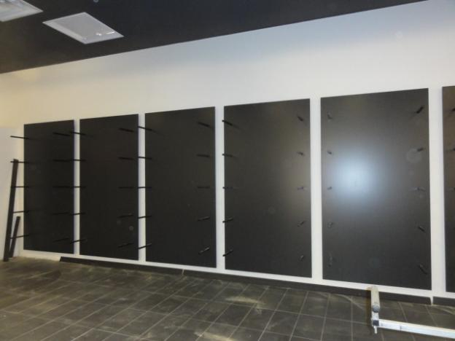
SHOE Fixture walls
Shoe fixture walls
South and east
Floor tile 100% complete
Modifications made to wall panels to
Insure proper fit
LED lights installed & working
Glass onsite
Missing glass clips and suction cups
To install
Due to arrive 12/23

